Slide 1
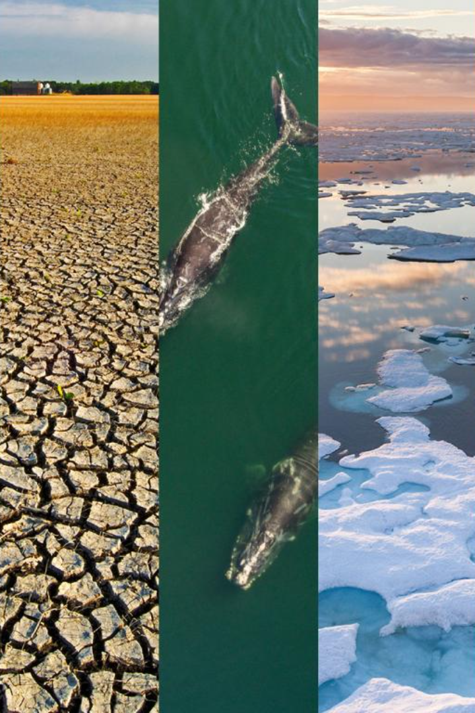

Interactive Climate Change Simulation and Prediction Platform
Explore the future of our planet through an interactive platform. Learn about feature engineering, model training, and evaluation to predict and understand climate change.

Slide 2

Importance of Climate Change Simulation and Prediction
Discover why accurately simulating and predicting climate change is crucial for understanding its impact on our environment and implementing effective mitigation strategies.

Slide 3

Purpose of the Interactive Platform
Uncover the goals and objectives behind the development of an interactive platform for climate change simulation and prediction, including increasing accessibility and awareness.

Slide 4
Feature Engineering in Climate Change Simulation
Delve into the process of feature engineering and its specific application in climate change simulation. Explore various techniques and methods to enhance model performance.
Natural Language Processing (NLP):
Scientific Literature Analysis: Apply NLP techniques to analyze climate-related research papers. Extract topics, emerging trends, and areas of active research. Use these insights to create features indicating the evolution of climate science knowledge.
Satellite Imagery Integration:
Remote Sensing Data: Utilize high-resolution satellite imagery to extract features like vegetation density, land cover types, and urban expansion. Advanced computer vision techniques, including object detection and segmentation, can convert images into actionable data.

Slide 5

Model Training: Decoding Climate Change
Get an overview of the model training process in climate change simulation, including the utilization of different machine learning algorithms, data preprocessing, and model selection.
Data Preparation:
Comprehensive Dataset: Compile a diverse and comprehensive dataset containing historical climate data, environmental factors, satellite imagery, and relevant engineering-related variables.
Data Cleaning: Cleanse the data to remove inconsistencies, outliers, and missing values. Ensure the dataset is homogeneous and suitable for training machine learning models.
Feature Engineering:
Incorporate Engineering Features: Engineer features specifically related to engineering variables such as energy consumption, infrastructure development, emission levels, and renewable energy adoption rates.
Climate-Engineering Interactions: Create interaction features between climate variables and engineering-related factors to capture their dynamic relationships
Model Selection:
Regression Models: Utilize regression models such as Linear Regression, Random Forest Regression, or Gradient Boosting Regression to predict climate variables based on engineering features.
Deep Learning: Experiment with neural networks, especially convolutional neural networks (CNNs) for processing satellite imagery data, to capture complex patterns

Slide 6

Evaluating Model Performance
Gain insights into the evaluation of climate change prediction models. Discover the metrics used, methods for validating predictions, and the inherent challenges and limitations.
Selecting Appropriate Metrics:
Regression Models:
Mean Squared Error (MSE): Measures the average squared difference between predicted and actual values. Lower MSE indicates a better fit.
Root Mean Squared Error (RMSE): RMSE is the square root of MSE, providing interpretable errors in the same unit as the target variable.
Mean Absolute Error (MAE): Computes the average absolute differences between predicted and actual values, offering a more intuitive understanding of errors.
Classification Models:
Accuracy: Measures the proportion of correctly classified instances. It's suitable for balanced datasets.
Precision, Recall, and F1-Score: Useful for imbalanced datasets, offering insights into false positives, false negatives, and overall model accuracy.
Real-World Testing:
Prototyping: Implement the model in a real-world prototype or simulation. Compare the model's predictions with actual observations in the physical system, validating its performance under practical conditions.
Continuous Monitoring: Implement continuous monitoring mechanisms, especially in systems that operate in dynamic environments, to track model performance over time

Slide 7
Activities on the Platform
Explore the interactive activities available on the platform. Engage in hands-on demonstrations of feature engineering, model training, and evaluation to deepen your understanding.
Climate Change Simulation Games:
Climate Challenges: Develop simulation games where users can take on the role of policymakers or environmental scientists, making decisions to mitigate climate change. Users can experience the consequences of their decisions in real-time simulations.
Multiplayer Collaboration: Enable multiplayer modes where users collaborate to solve climate-related challenges. Encourage teamwork and innovative problem-solving.
Educational Quizzes and Challenges:
Climate Change Quizzes: Create interactive quizzes testing users' knowledge about climate change, its impacts, and potential solutions. Offer rewards or badges for completing challenges.
Scenario-based Challenges: Present users with real-world climate-related challenges and ask them to devise solutions. Users can see the outcomes of their proposed solutions within the platform.

Slide 8

In Conclusion: Empowering Climate Change Research
empowering climate change research means giving scientists the tools, data, and support they need to understand our changing planet. By investing in innovative technologies and collaborative efforts, we can uncover valuable insights, find sustainable solutions, and inspire global action.

Slide 9
DETAILS(phase 4 submission)
1
TITLE:
Interactive Climate Change Simulation and Prediction Platform.
2
STUDENT DETAILS:
Name: HARIRAJAN.S
phase: DEVELOPMENT PHASE 2
Student ID: 410721104045

